Slide 1

Department of Computer Science and Engineering
Music Genre Classification using ML Algorithms
B. CHARITHA : 17WH1A0597​
G. ANITHA : 17WH1A0586
K. ANJALI : 18WH5A0514
Internal Guide: Ms. G. SHANTI​
Designation: Assistant Professor

Slide 2

Abstract
Why Should I Study this course?
Music genre classification is used to classify the audio files to a particular category for example, blues, classical, country, hip hop, rock, disco, etc. Categorizing music files according to their genre is a challenging task and cannot be done manually. This project automates the classification of audio files by extracting the spectral features, classifying the audio file based on the extracted features. Classification methods like K Nearest Neighbours, Naïve Bayes, Decision Tree, Random Forest, Support Vector Machine were employed. Furthermore, Convolutional Neural Network-CNN is also used to classify genres, where spectrograms of audio files are fed to CNN to obtain the feature vector.
Examples
BVRIT HYDERABAD College of Engineering for Women

Slide 3
Dataset
Why Should I Study this course?
Dataset : GTZAN Genre Collection
http://marsyas.info/downloads/datasets.html
The dataset consists of 1000 audio tracks each 30 seconds long.
(blues, classical, country, disco, hip hop, jazz, metal, pop, reggae, rock)
It contains 10 genres, each represented by 100 tracks.
The tracks are all 22050Hz Mono 16-bit audio files in .wav format.
The files were collected in 2000-2001 from a variety of sources including personal CDs, radio, microphone recordings, in order to represent a variety of recording conditions.
Examples
BVRIT HYDERABAD College of Engineering for Women

Slide 4
Technology Stack
Why Should I Study this course?
Python 3.9
Libraries :
Librosa - Librosa is a python package for music and audio analysis. I helps to visualize the audio signals and also do the feature extractions in it using different signal processing techniques
Pandas - Pandas is used for data analysis such as cleaning, manipulating, transforming, etc
Numpy - Numpy is a python library, it is used to perform a number of mathematical operations on arrays.
Tkinter - Tkinter is a Python binding to the Tk GUI toolkit. It is the standard Python interface to the Tk GUI toolkit, and is Python's de facto standard GUI.
Examples
BVRIT HYDERABAD College of Engineering for Women

Slide 5
Architecture for CNN
Architecture
Why Should I Study this course?
Why Should I Study this course?
Audio files from dataset
Generating spectrogram for each audio file
Feeding spectrograms to CNN
Dense layer feature vector
Examples
Examples
Feature extraction from audio files
Classification models
Evaluation
BVRIT HYDERABAD College of Engineering for Women
BVRIT HYDERABAD College of Engineering for Women

Slide 6
Feature Extraction
Spectral features are extracted by converting time based signal into frequency domain.
Features extracted are :
zero crossing rate
Spectral centroid
Spectral roll off
Spectral contrast
Spectral bandwidth
Mel Frequency Cepstral coefficients

Slide 7
Architecture for CNN
Architecture for CNN
Why Should I Study this course?
Why Should I Study this course?
Audio files from dataset
Generating spectrogram for each audio file
Feeding spectrograms to CNN
Dense layer feature vector
Examples
Examples
Generate spectrograms from audio files
Convolutional Neural Network
Evaluation
BVRIT HYDERABAD College of Engineering for Women
BVRIT HYDERABAD College of Engineering for Women

Slide 8
CNN
Applying Short term Fourier transform to the audio file
Generating spectrograms for the audio files
Feeding spectrograms to CNN
Generating feature vector which is used to classify audio file

Slide 9
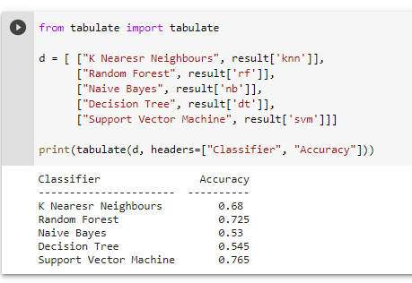
Output

Slide 10
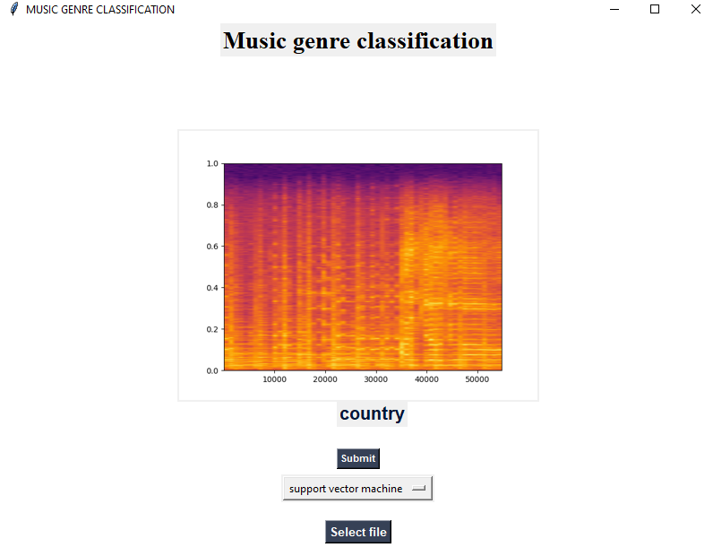
Output

Slide 11
Conclusion
Why Should I Study this course?
This project was aimed to tackle the problem of automatic music genre classification based on various features. Firstly extraction of spectral features from audio files is done by feature extraction and selection, lastly followed by classification. Here, we focused our spectrum of features as these act as a good metric for human perception of music. Through feature analysis and classification, a maximum accuracy of 70% was obtained.
Examples
BVRIT HYDERABAD College of Engineering for Women

Slide 12
References
Why Should I Study this course?
[1] Elbir, A., Bilal Cam, H., Emre Iyican, M., Ozturk, B., & Aydin, N. (2018). Music Genre Classification and Recommendation by Using Machine Learning Techniques. 2018 Innovations in Intelligent Systems and Applications Conference .
[2] Karunakaran, N., & Arya, A. (2018). A Scalable Hybrid Classifier for Music Genre Classification using Machine Learning Concepts and Spark. 2018 International Conference on Intelligent Autonomous Systems
[3] Vishnupriya, S., & Meenakshi, K. (2018). Automatic Music Genre Classification using Convolution Neural Network. 2018 International Conference on Computer Communication and Informatics (ICCCI)
Examples
BVRIT HYDERABAD College of Engineering for Women

Slide 13
Thank you

